Slide 1







VIRTUAL
FUNHUB
Vedant Rajpurohit (20SE02ML036)
Manan Patel (20SE02ML034)
Rinkesh Patel (20SE02ML035

Slide 2
I
N
T
R
O
D
U
C
T
I
O
N
This Project looks into Virtual reality (VR) offers a unique platform for visual representation. As means of communication, Interacting with the Machine without touching it.
Playing Virtual games is possible through our trending technology namely open cv, python, media pipe.
This Project (Virtual FUNHUB) will be used for the entertainment purpose
For playing games with the Machine Artificially
The interaction between people and the machines is mainly completed through the mouse, keyboard, remote control, touch screen, and other direct contact manner. While our project looks into the concepts of Virtual Reality (VR).

Slide 3
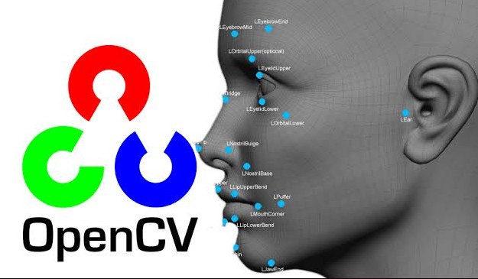
OPENCV
OpenCV (Open-Source Computer Vision Library) is a library which mainly focuses at real-time computer vision. It is free for both academic and commercial use. It has C++, C, Python and Java interfaces and supports Windows, Linux, Mac OS, iOS and Android. OpenCV was designed for computational efficiency and with a strong focus on real-time applications. The library has more than 2500 optimized algorithms, which includes a comprehensive set of both classic and state-of-the-art computer vision and machine learning algorithms. It provides basic data structures for image processing with efficient optimizations

Slide 4
O
B
J
E
C
T
I
V
E
To Have a platform to play your favourite games artificially using AI.
To detect human fingers and analysing it to have control of the games and play them.
To Add Morphological Operations (a broad set of image processing operations that process images based on shapes. In a morphological operation, each pixel in the image is adjusted based on the value of other pixels in its neighbourhood.)
To create an interface between user and the System using different imported libraries and software.
It Can also be used as a learning platform for kids to comprehend different making of games Artificially.

Slide 5
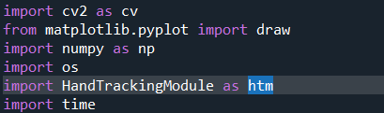
VIRTUAL FUNHUB
OpenCV (cv2) : It is a library which mainly focuses at real-time computer vision
Matplotlib : It is library which is used to import graphs and charts (in this project used to import draw HandMarks and LandMarks)
Numpy : It is library used to create an flexible arrays
Os : It is operating system library used to import or remove images and files from the file explorer directories
HandTrackingModule : It is the module create by us to track hand landmarks.
Time :- It is library used to get time related values (in this project used to calculate FPS)
Libraries Used

Slide 6
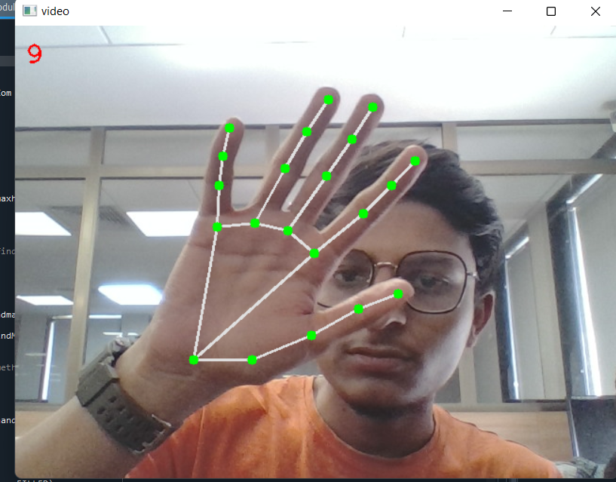
VIRTUAL FUNHUB
HandTrackingModule
The Module create by us used to track all the HandLandMarks locations and assigning them with unique ID’s
The Number Showing at the Top left Corner shows the current Frame rate (FPS).
It can Track as many hands on the screen at time. If you increase the value of “maxhands” in the code.

Slide 7
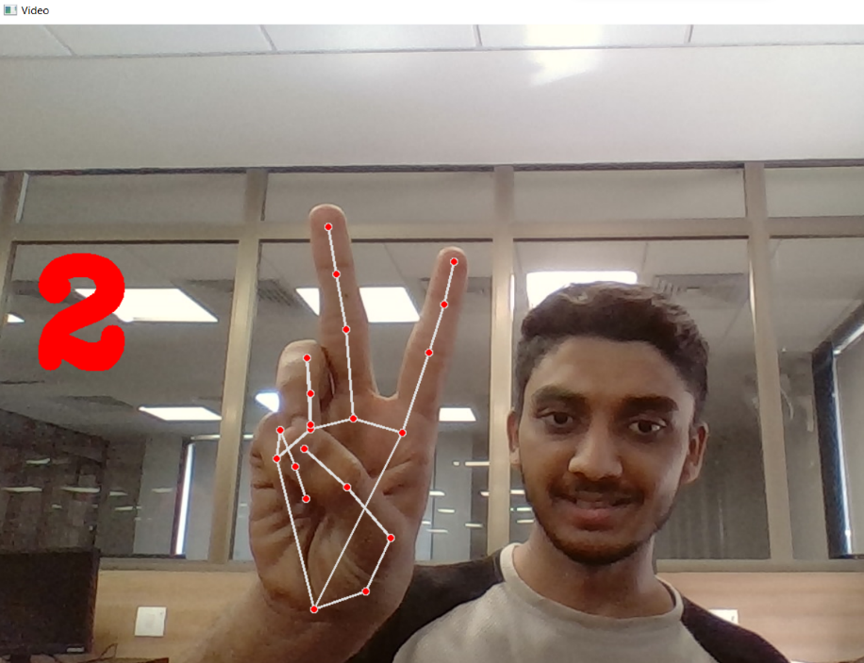
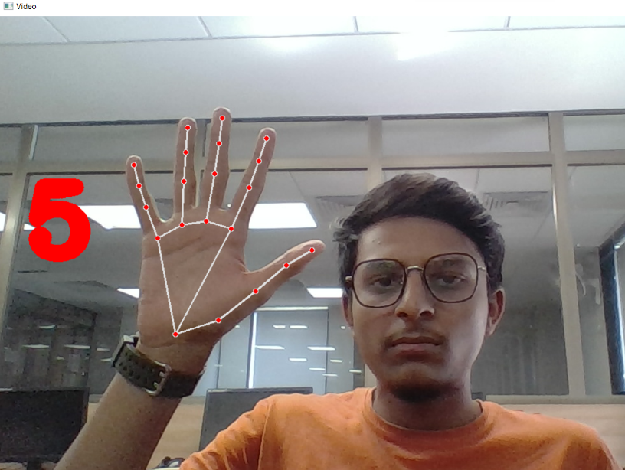
VIRTUAL FUNHUB
Counting Fingers
The Module create by us used to track all the HandLandMarks locations and checking number of fingers open/Up and counting Them. Which is used to scan for many purposes like (in Rock Paper & Scissors game sscan if 2 fingers up then it must be Scissors or no finger up then must be Rock Etc.)
If no finger is up then it will show zero digit as no finger is open/Up

Slide 8
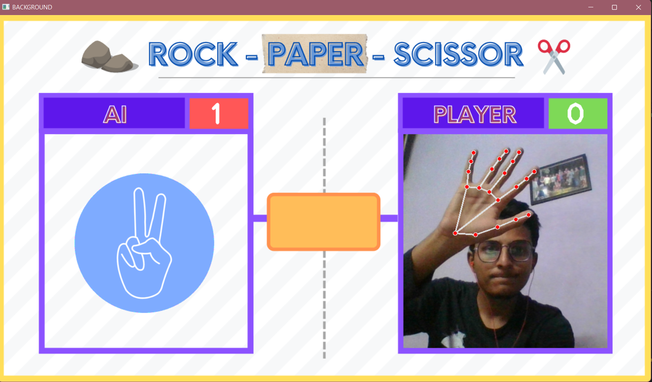
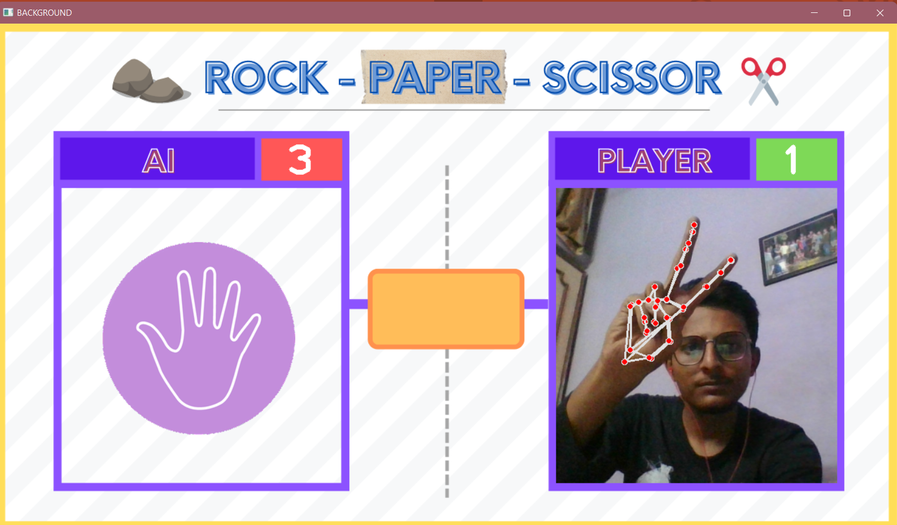
VIRTUAL FUNHUB (Some of the Games)
Rock Paper & Scissors

Slide 9
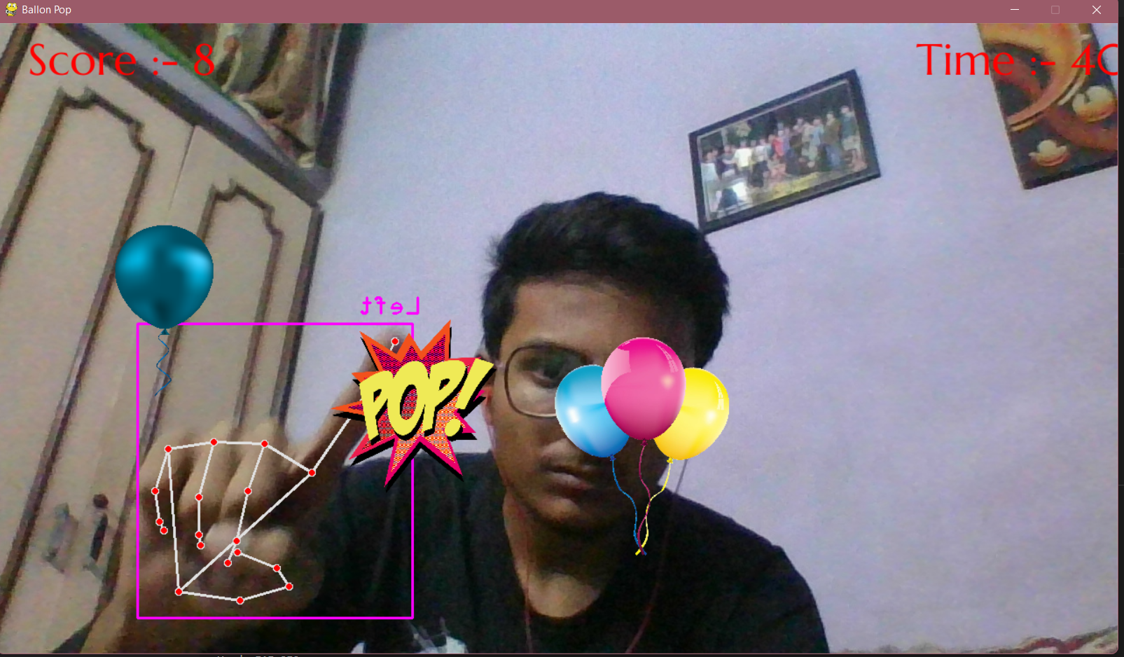
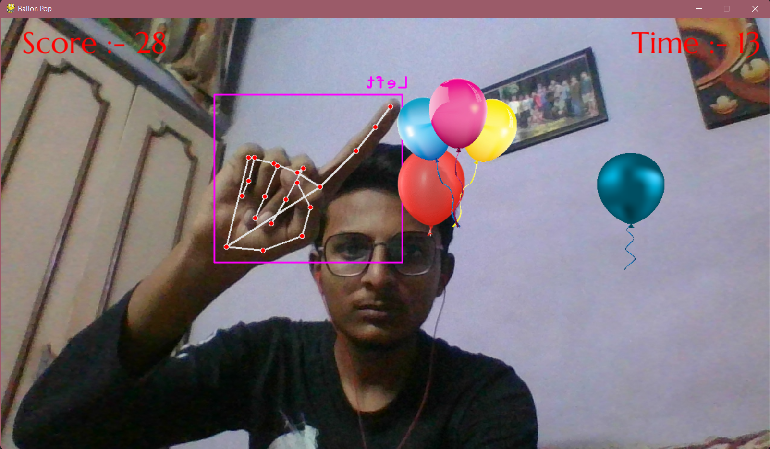
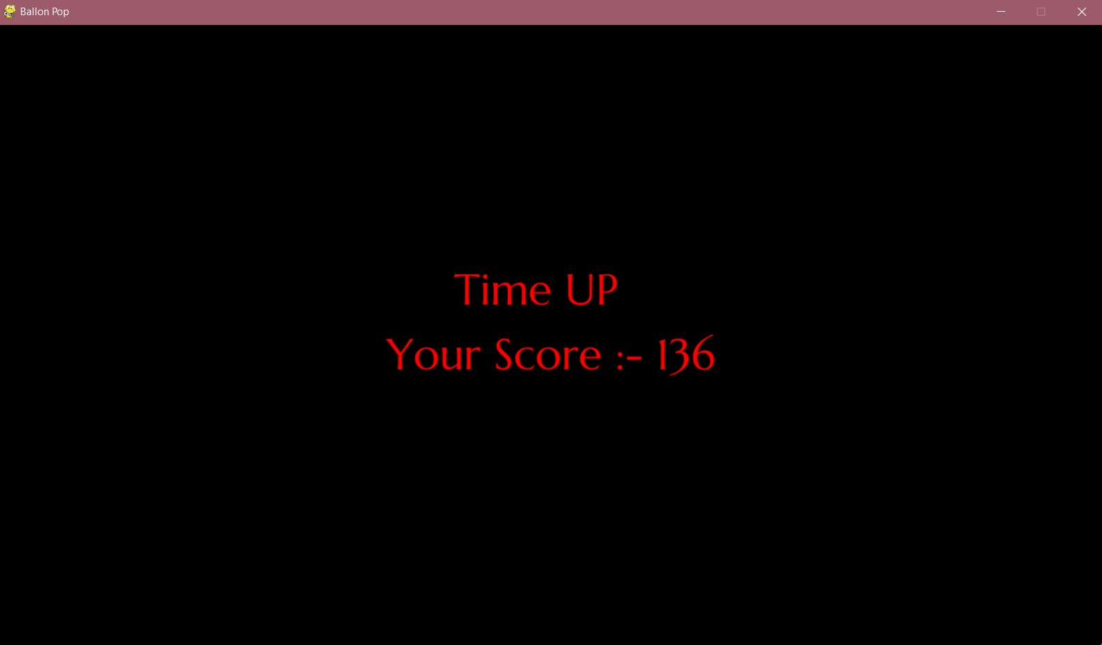
VIRTUAL FUNHUB (Some of the Games)
Pop The Balloons

Slide 10
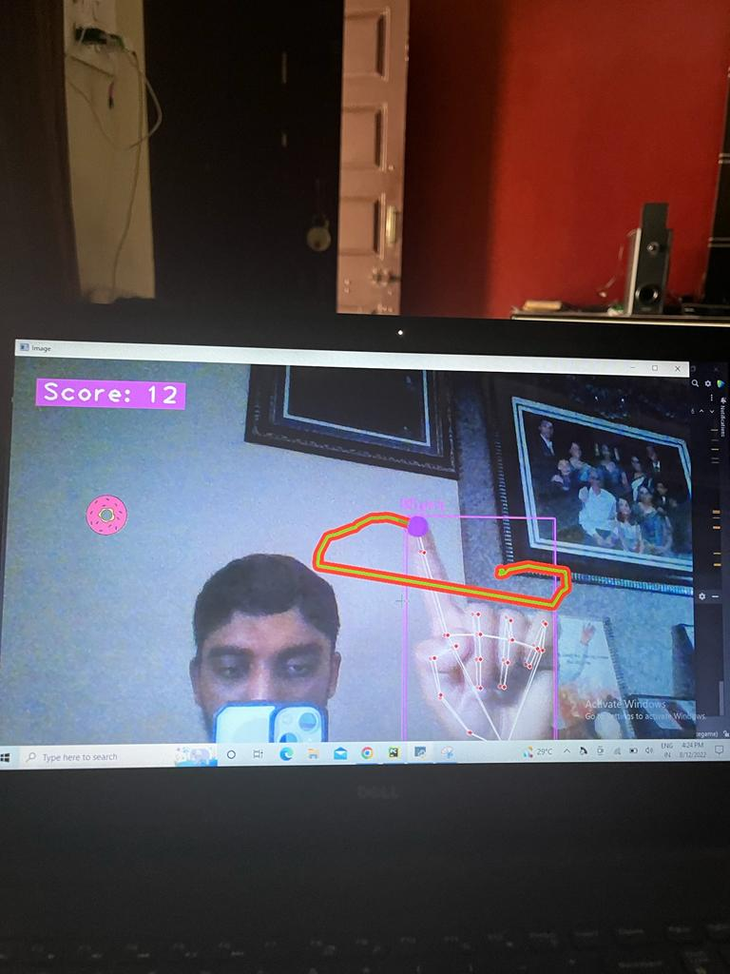
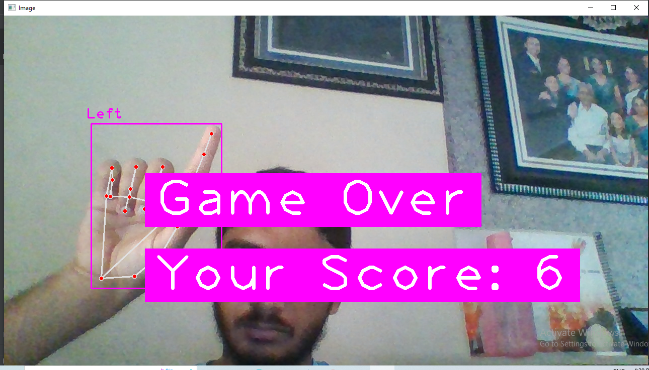
VIRTUAL FUNHUB (Some of the Games)
Snake Games

Slide 11
L
I
M
I
T
A
T
I
O
N
S
A person cannot identify a greater number of hands after a point.
You need a wide scale of screen to use it efficiently.
You cannot have multiple users play at same time
You need high brightness to detect hand and use if efficiently.
You need high system requirements and specific python libraries to use opencv hand and motion detection.

Slide 12
A
K
T
N
O
H
U
Y

